Slide 1
Crime Reporting and Rating System
SARTHAK GUPTA(1081110038)

Slide 2
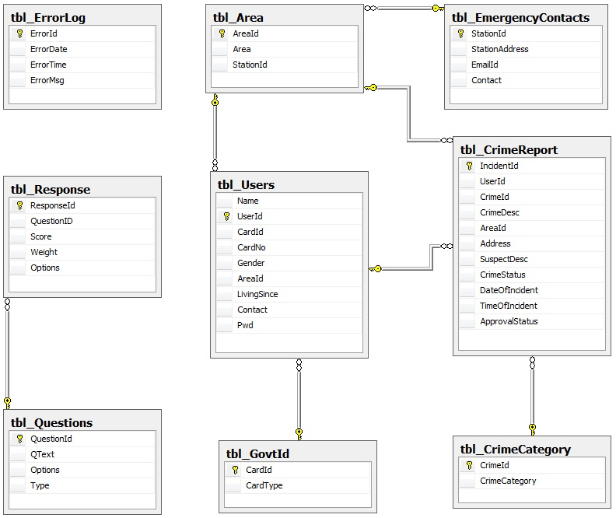
ORGANISATION OF DATABASES

Slide 3
TABLES/FILES OR ENTITIES
AREA
AreaId INT(4)
AreaName VARCHAR(20)
StationId INT(4)
CRIME CATEGORY
CrimeId INT(4)
CrimeCategory VARCHAR(20)

Slide 4
TABLES/FILES OR ENTITIES
Users
Name VARCHAR(50)
UserId VARCHAR(15)
CardId INT(4)
CardNo VARCHAR(20)
Gender VARCHAR(1)
AreaId INT(4)
LivingScience DateTime(4)
Contact VARCHAR(10)
Pwd VARCHAR(15)

Slide 5
TABLES/FILES OR ENTITIES
Govt Id
CardId INT(4)
CardType VARCHAR(30)
Questions
QuestionId INT(4)
Qtext VARCHAR(400)
Option VARCHAR(400)

Slide 6
TABLES/FILES OR ENTITIES
Crime Report
IncidentId VARCHAR(7)
UserId VARCHAR(7)
CrimeId INT(4)
CrimeDesc VARCHAR(200)
AreaId INT(4)
Address VARCHAR(200)
SuspectDesc VARCHAR(200)
CrimeStatus VARCHAR(20)
DateOfIncident DateTime(8)
TimeOfIncident VARCHAR(10)

Slide 7
TABLES/FILES OR ENTITIES
Emergency Contacts
StationId INT(4)
StationAddress VARCHAR(200)
EmailId VARCHAR(30)
Contact VARCHAR(10)
Error Log
ErrorId Int(4)
ErrorDate DateTime(8)
ErrorTime VARCHAR(10)
ErrorMsg VARCHAR(100)

Slide 8
TABLES/FILES OR ENTITIES
Responses
ResponseId INT(4)
QuestionId INT(4)
Score VARCHAR(2)
Weight VARCHAR(2)
Option VARCHAR(2)

Slide 9
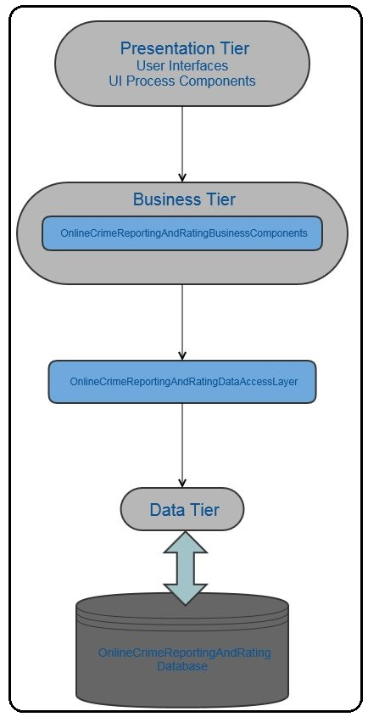
HIGH LEVEL DESIGN ARCHITECTURE

Slide 10
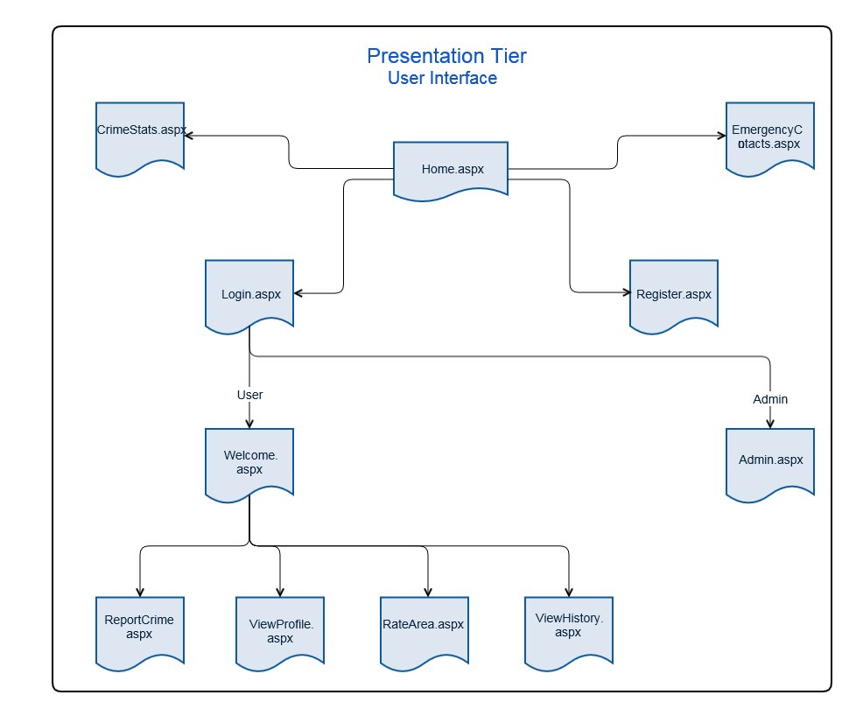
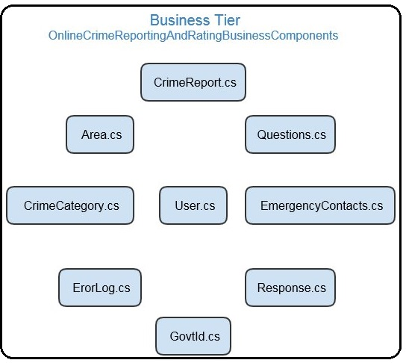
SUBSYSTEMS
Presentation Tier
Business Tier

Slide 11
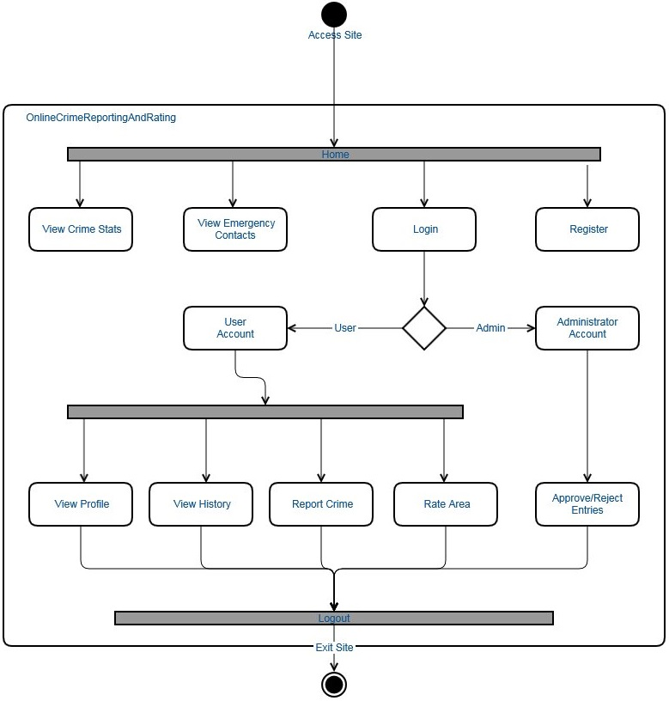
MODELLING

Slide 12
CRITICAL MODULES
Home.aspx
Login.aspx
Register.aspx
Admin.aspx
Welcome.aspx
View Profile.aspx
ReportCrime.aspx
ViewHistory.aspx
RateArea.aspx
CrimeReportAndStats.aspx
EmergencyContacts.aspx

Slide 13
ORDER OF INTEGRATION
Home → Login
Home → Register
Home → EmergencyContacts
Home → CrimeReportsAndStats
Login → Welcome
Login → Admin
Welcome → ReportCrime
Welcome → ViewProfile
Welcome → ViewHistory
Welcome → RateAnArea
Register → Welcome

Slide 14
Hardware/Software And Platform
Hardware requirements
Processor/RAM/HDD : Intel Pentium III (or equivalent AMD Processor) and above / 1 GB RAM
Web server : NA
Database Server : Microsoft SQL Server 2008 R2
Software requirements
OS for Web server : NA
OS for Database Server : Microsoft Windows Server 2008 R2
DBMS : Microsoft SQL Server 2008 R2
Third Party S/Ws : NA

Slide 15
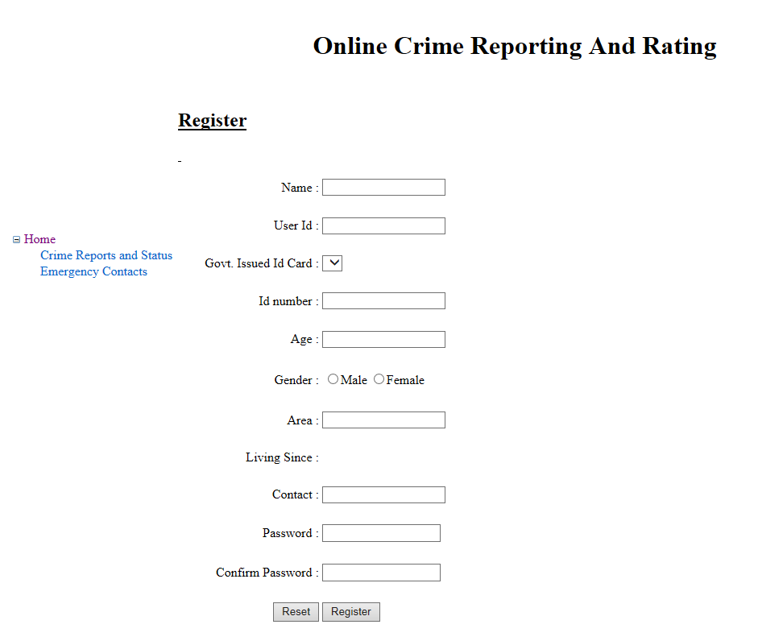
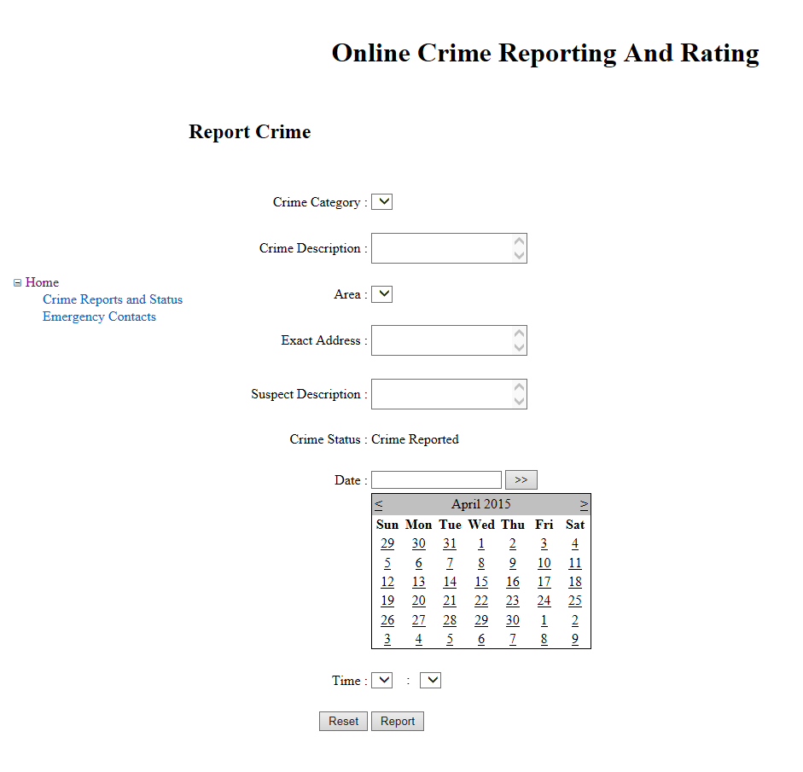
Design Decision Prototypes

Slide 16
CONCLUSION
Online Crime Reporting and Rating System is an ambitious project optimistically aimed at making the society more aware of the everyday crimes that takes place and go unreported. The motivation behind the project is the motto “Empowerment through Awareness”, because Ignorance is not always a bliss.
The prime objective of this system is to enable the end users to report crime tagged to a location and also be able to view all the reports filed by other users. As an innovative add-on the team will also aim at implementing functionalities that will extract statistical information from the reported data.

Slide 17
THANK YOU!!

